Slide 1
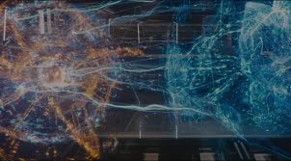
Intro to Deep Learning
Backpropagation done right
By: Ismail Elezi ismail.elezi@gmail.com
Nasty monsters will be summoned if there are no questions!!!

Slide 2
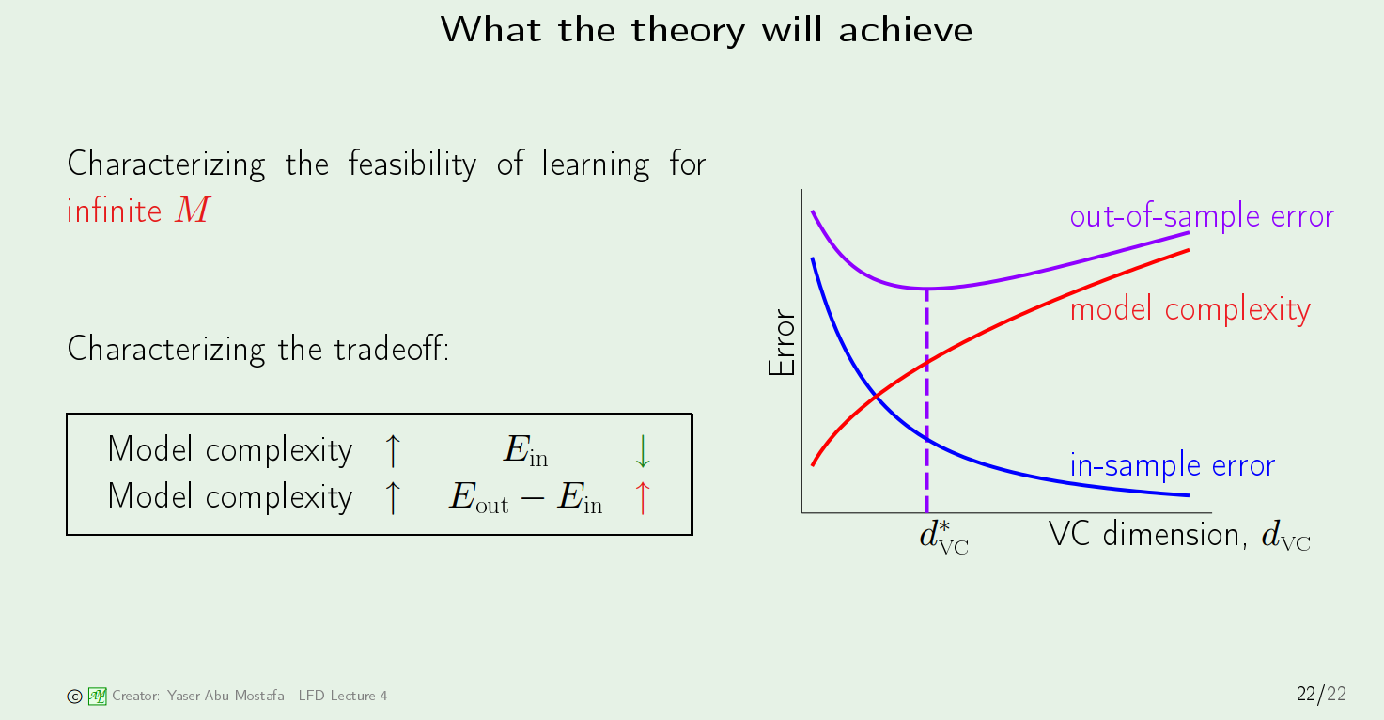
Review of last lecture (1)

Slide 3
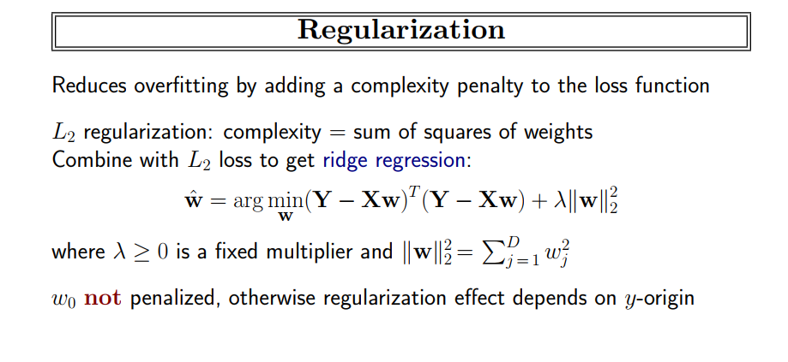
Review of last lecture (2)

Slide 4
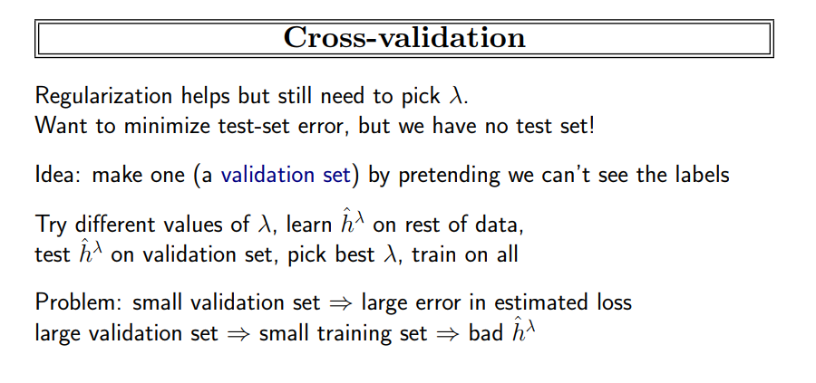
Review of last lecture (3)

Slide 5
Why Deep Learning/Neural Networks
Deep Learning is by far the dominant sub-discipline of ML
(Almost) everything in Computer Vision, Natural Language Precision and Speech Recognition is powered by deep learning. Its usage in Robotics is increasing.
It is not (yet!) the preferred approach in 3d reconstructions, graph datasets and vectorial datasets.
It is likely that this will change in the next few years, and deep learning will rule those fields too.
Most importantly - it isn’t covered on depth in any of the courses at the department.

Slide 6
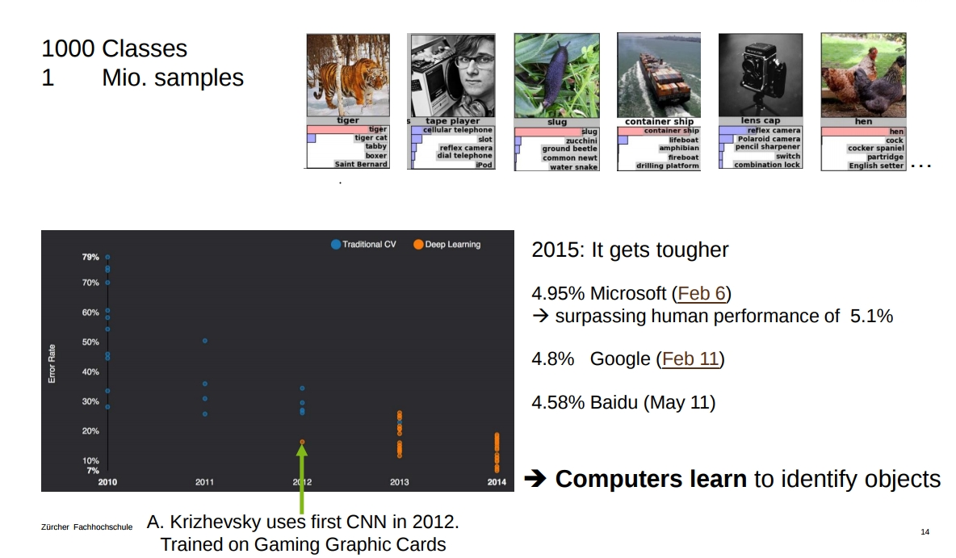
Credit: T. Stadelmann

Slide 7
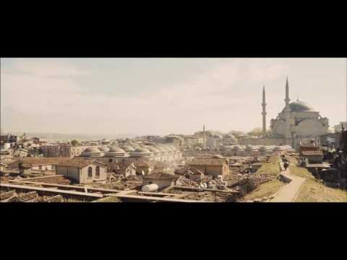

Slide 8
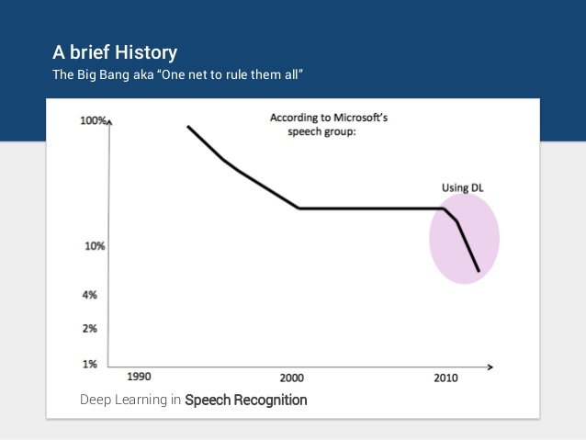

Slide 9
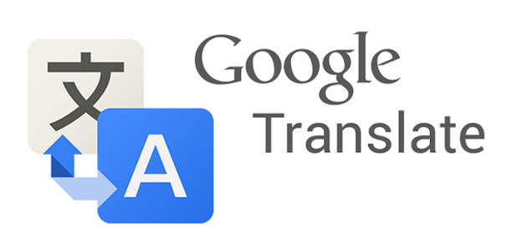

Slide 10
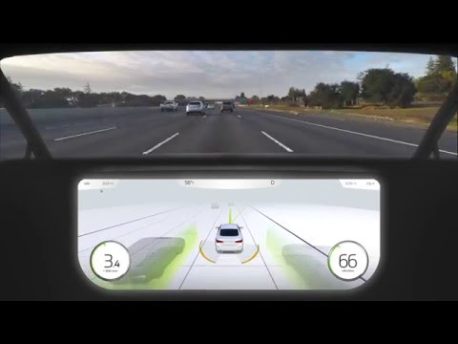

Slide 11
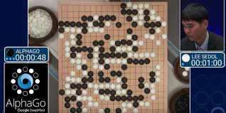

Slide 12
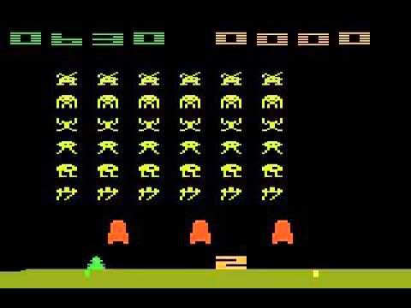

Slide 13
Tentative plan of deep learning seminars
Back-propagation and fully connected neural networks. (Today)
Convolutional Neural Networks.
Making neural networks work well.
Recurrent Neural Networks.
Generative Adversarial Networks
We’ll try to learn a deep learning library (PyTorch) as we move on, by doing some (optional) assignment.
And to read a few papers.

Slide 14
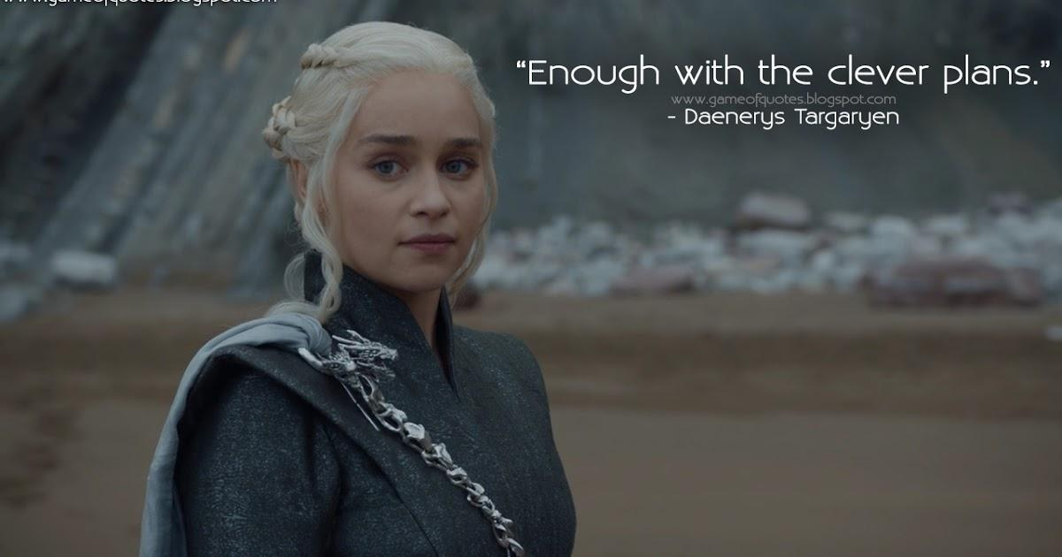

Slide 15
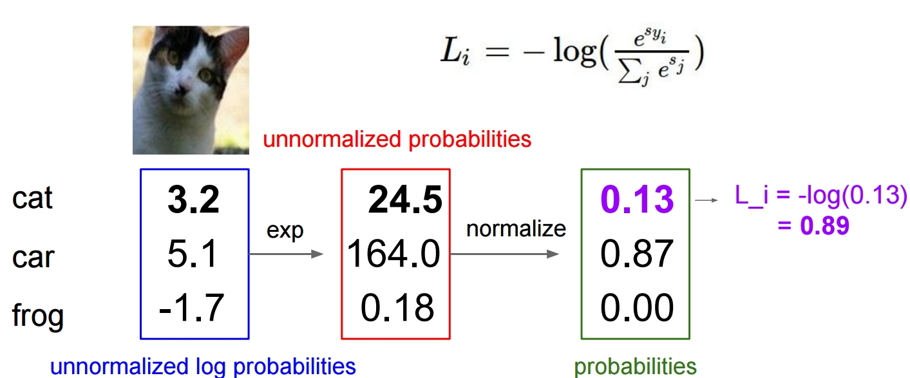
Remember the softmax classifier?

Slide 16
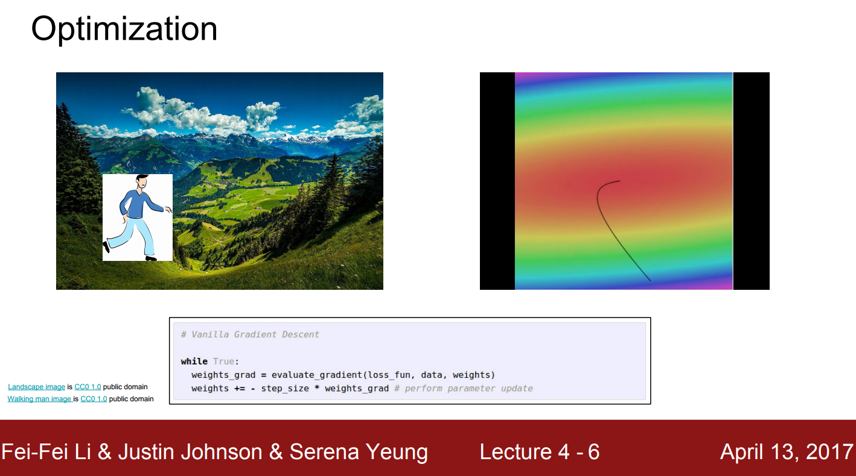

Slide 17
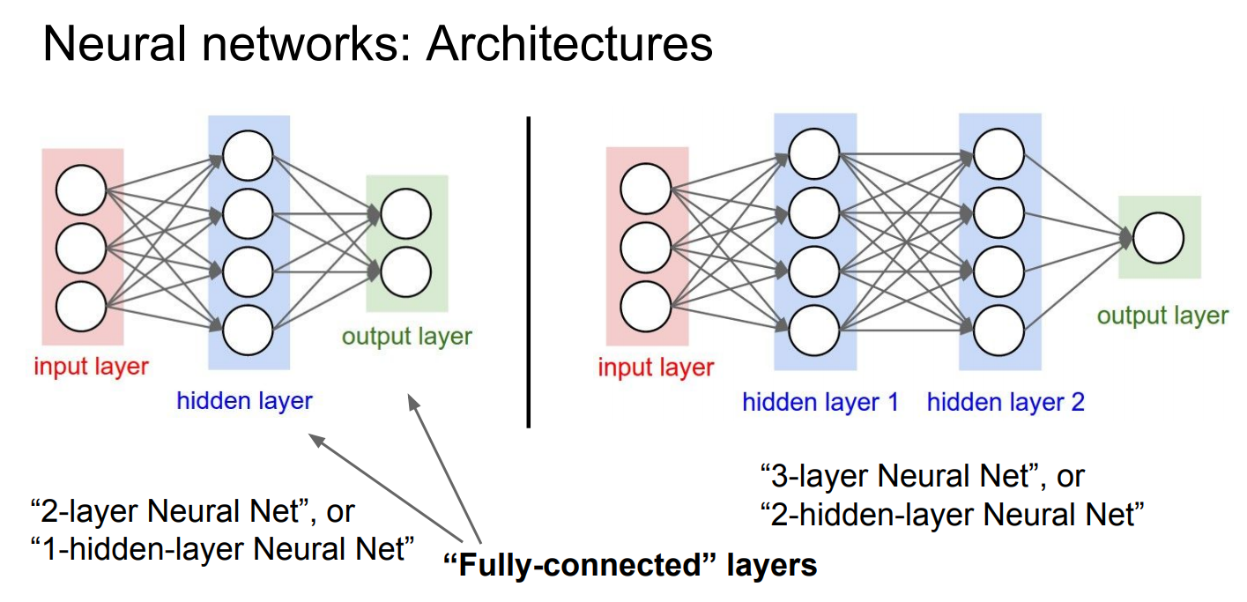

Slide 18
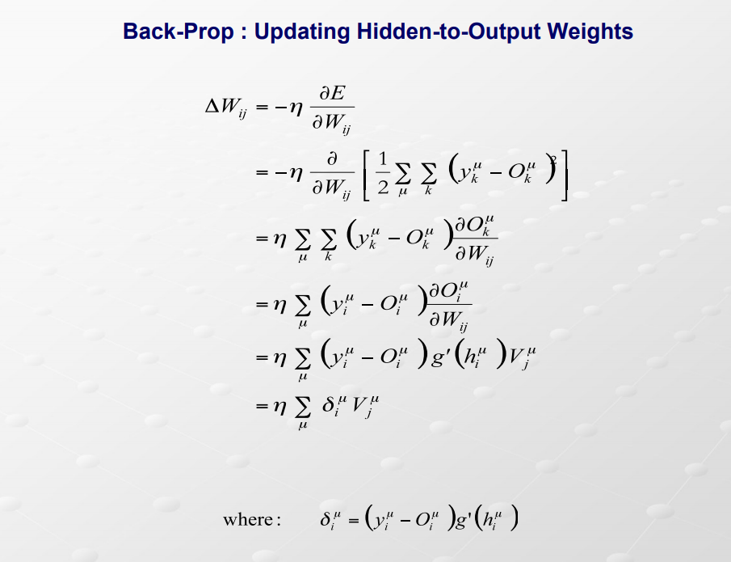
Once upon a time in machine learning books ...

Slide 19
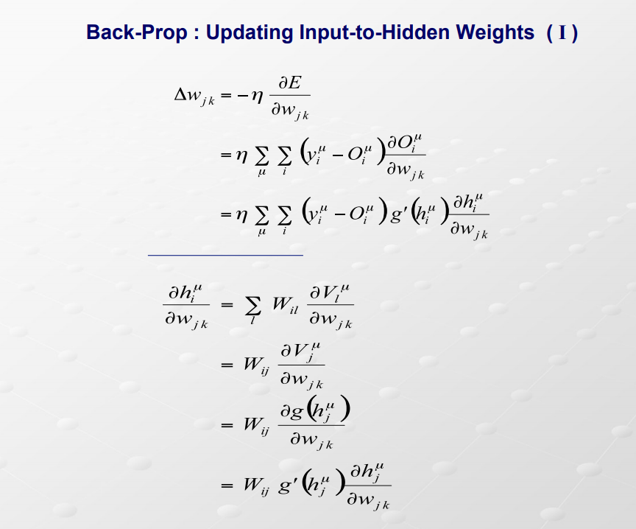
Once upon a time in machine learning books ...

Slide 20
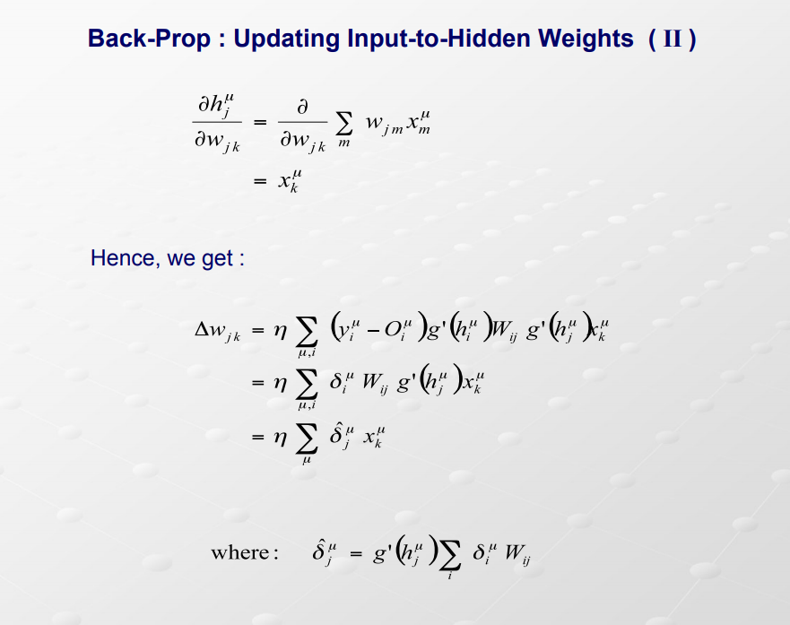
Once upon a time in machine learning books ...

Slide 21
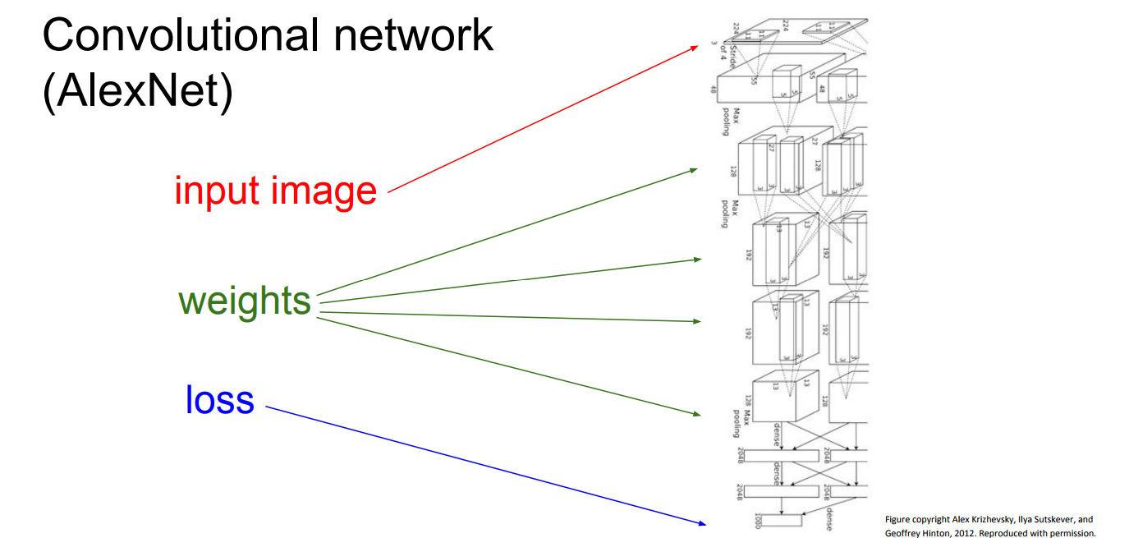

Slide 22
Back-prop done ‘badly’
The last few slides had nothing wrong.
In fact, they are mathematically correct, and might even give some insight in what is going on.
The problem is that they are next to useless in practice. Try to compute by hand the derivatives of an 152 layer neural networks. After 3 years of derivation, spend the following 2 years by coding those derivatives.
Unfortunately, the old books explained back-prop in that way. That gave the impression that back-prop is a very complicated algorithm, and a lot of people treated it as a black-box.
Back-prop isn’t difficult at all. New books (Goodfellow et al.) even explain it well. We all have to thank Andrej Karpathy about that.

Slide 23
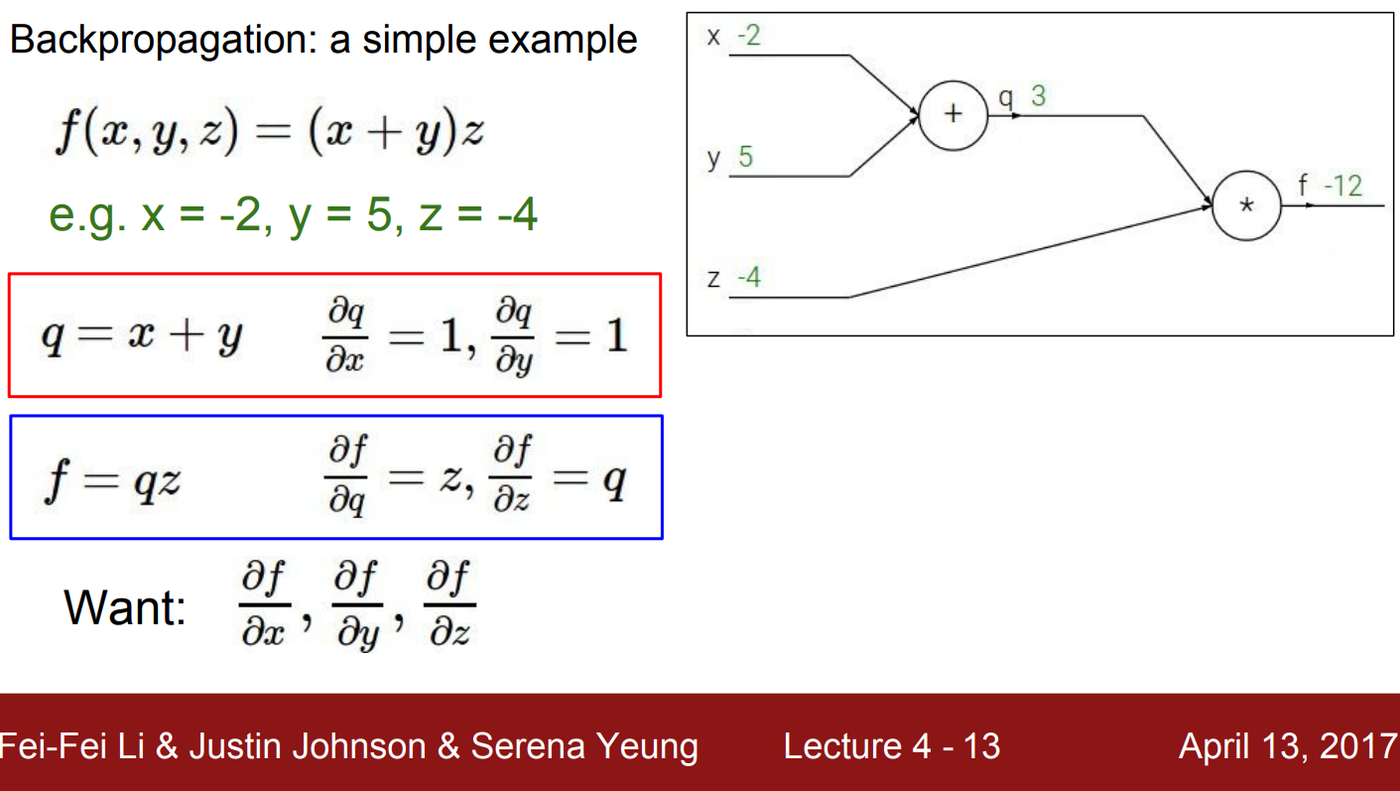

Slide 24
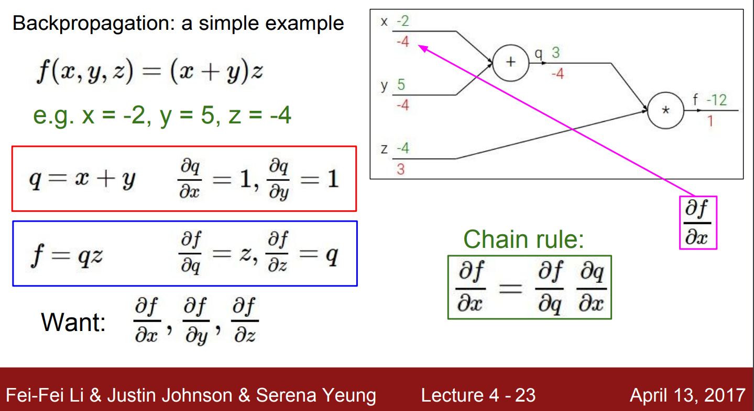

Slide 25
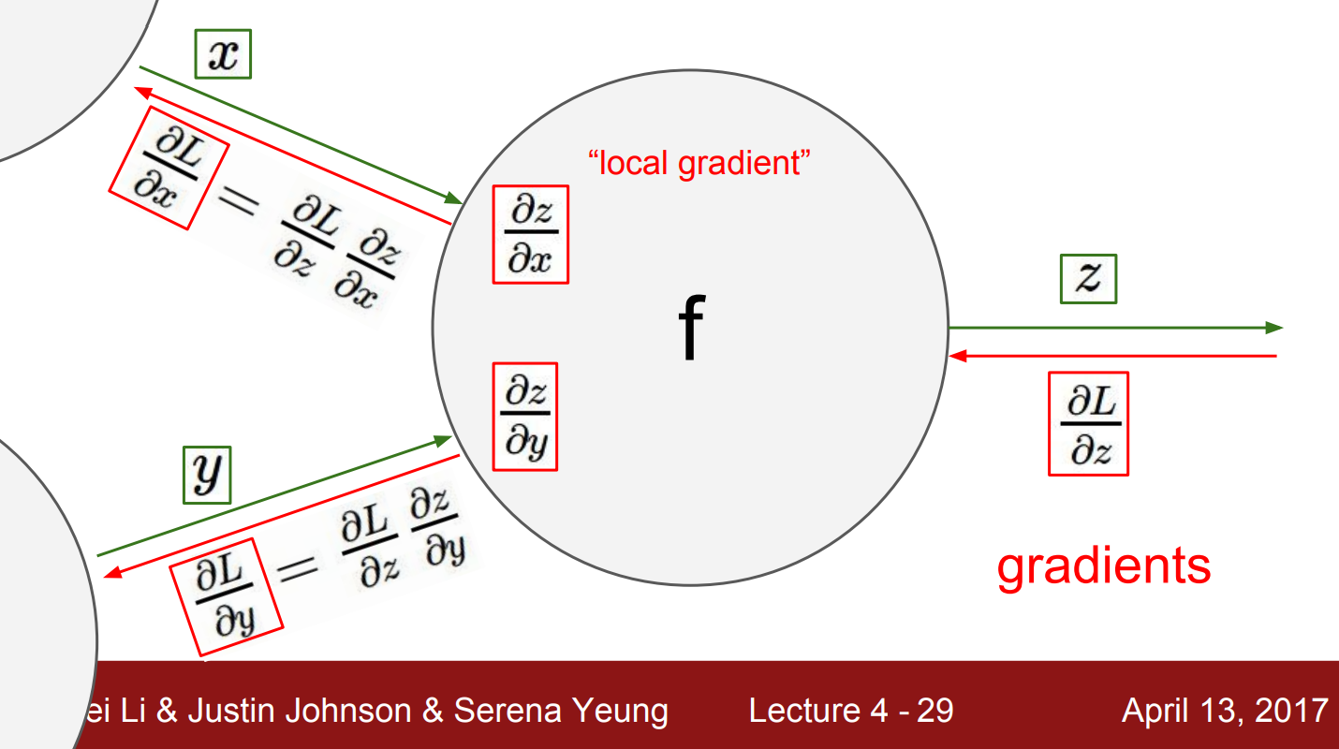

Slide 26
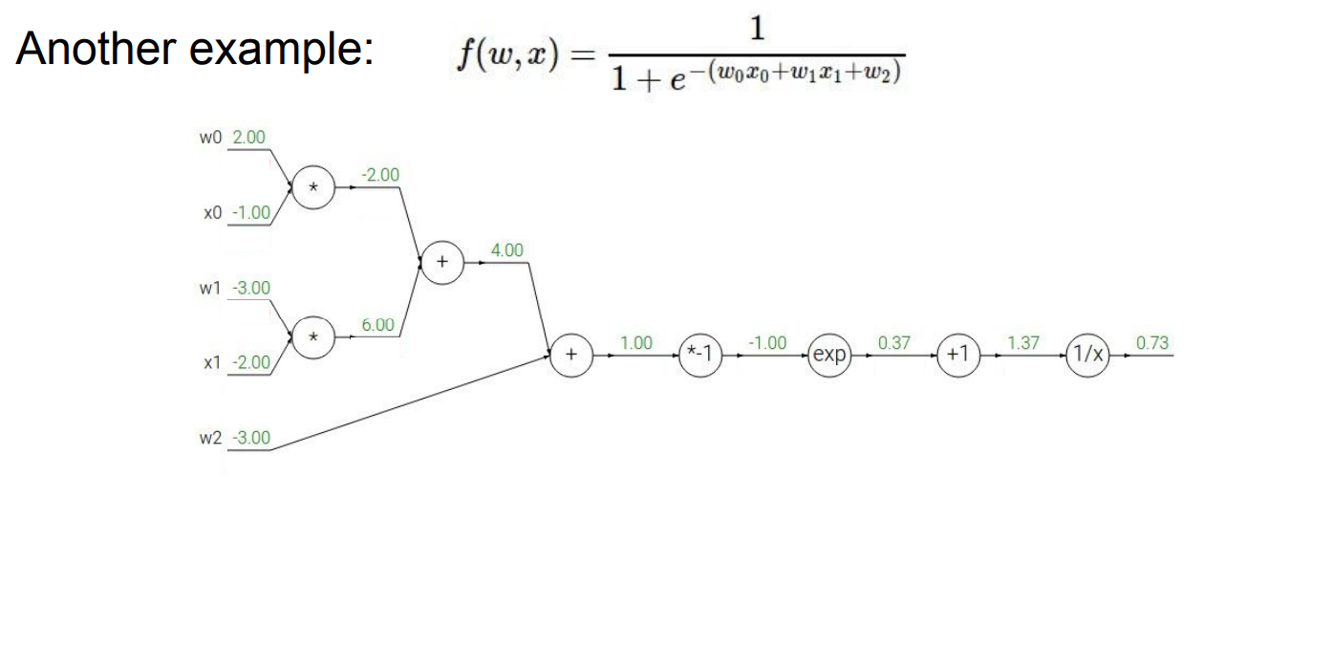

Slide 27
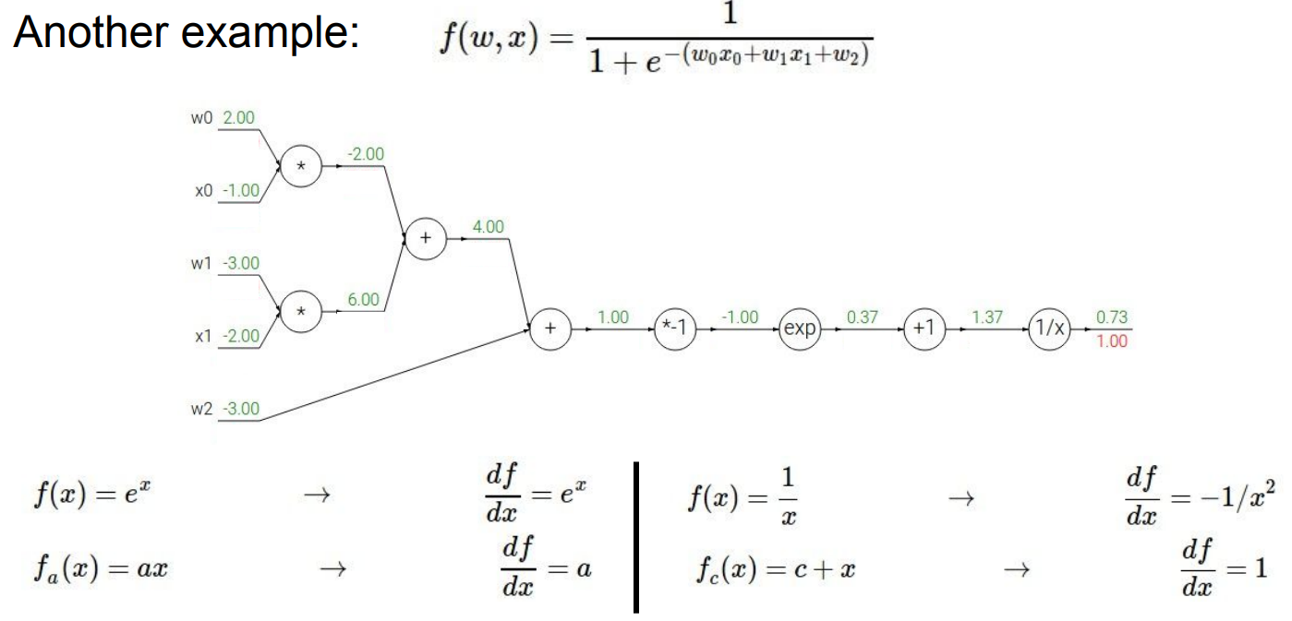

Slide 28
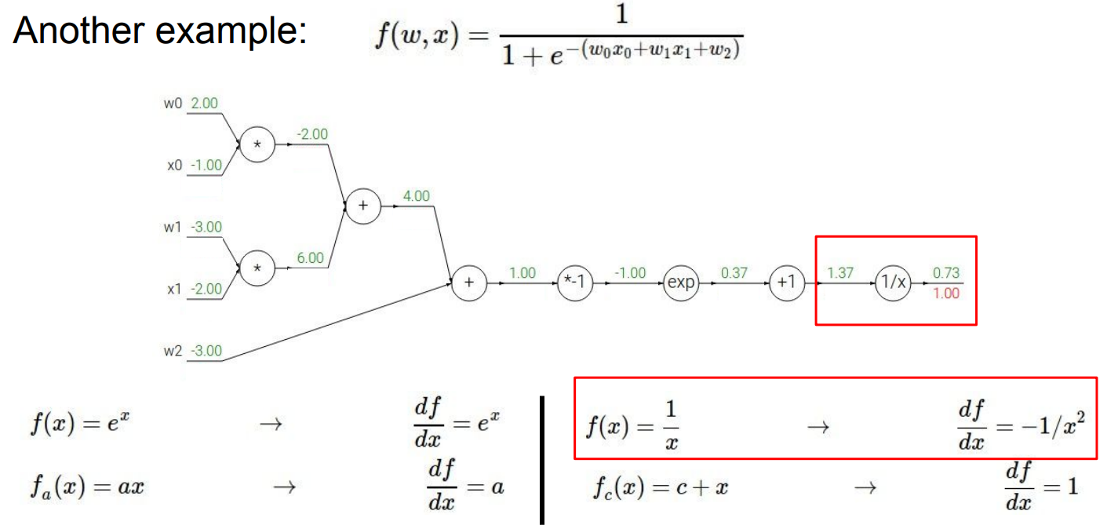

Slide 29
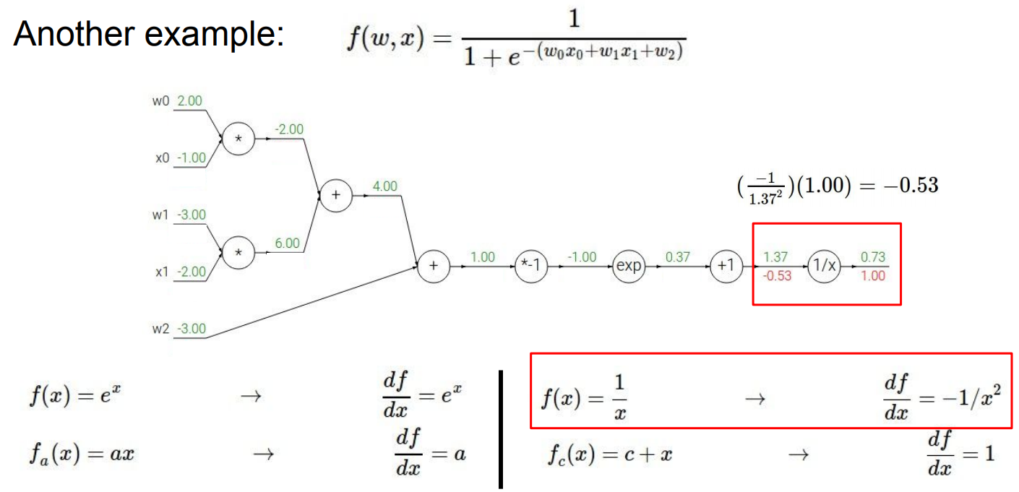

Slide 30
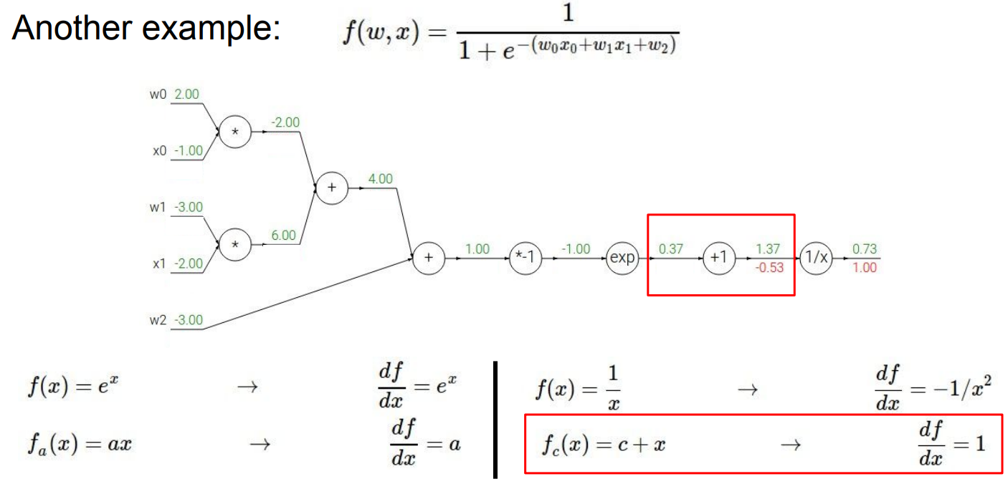

Slide 31
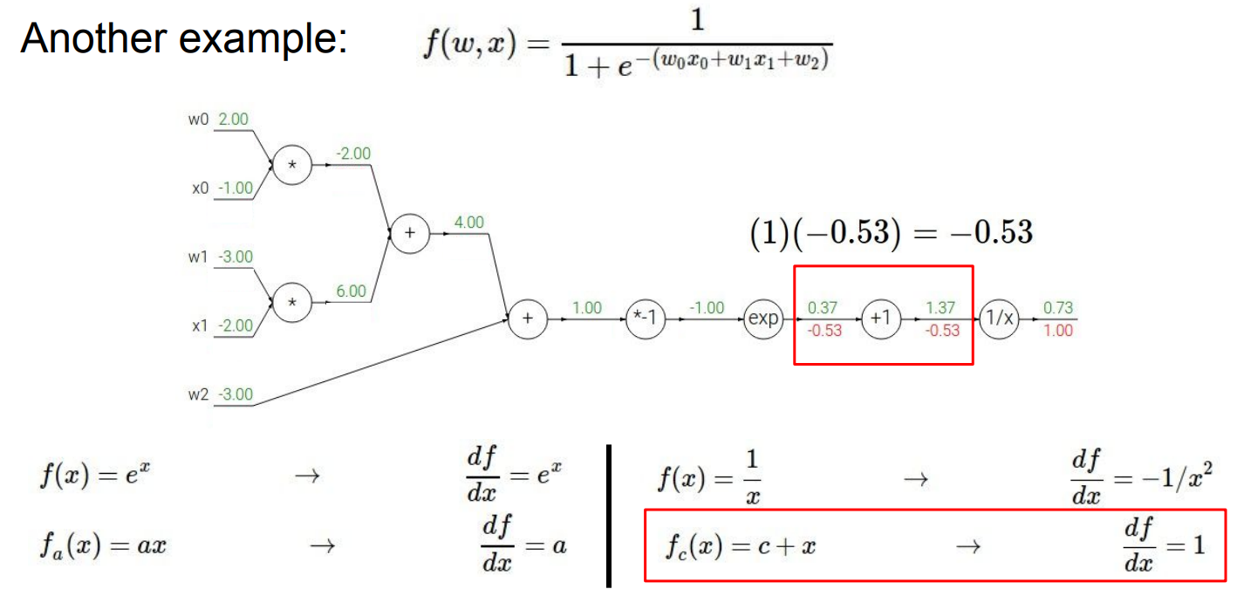

Slide 32
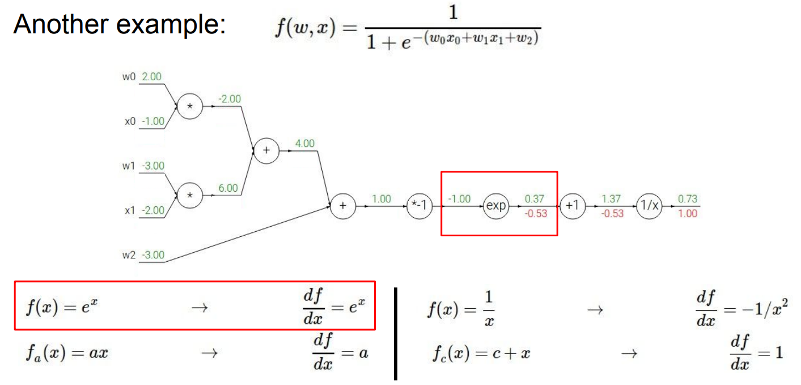

Slide 33
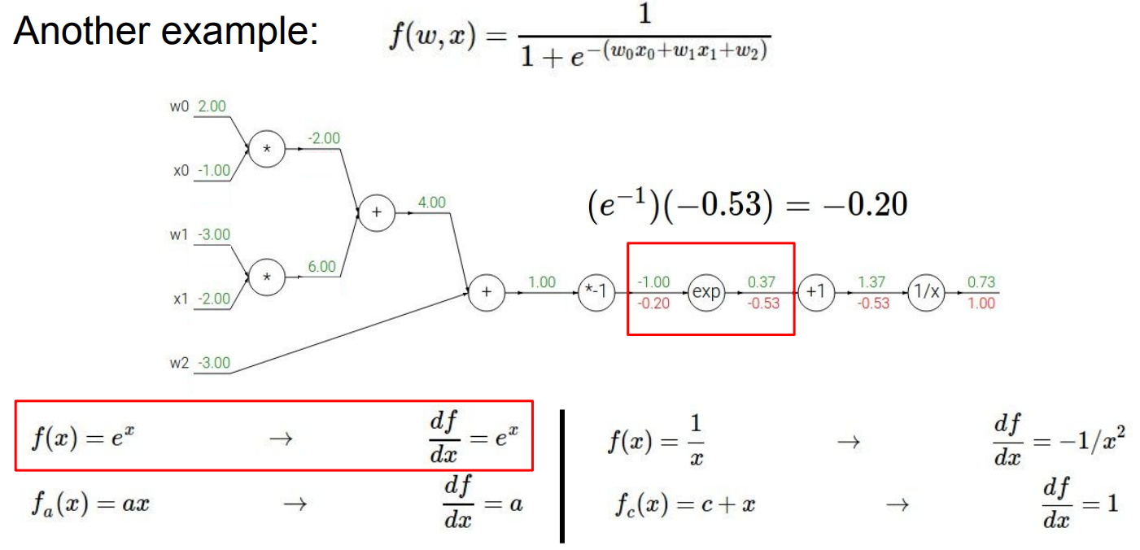

Slide 34
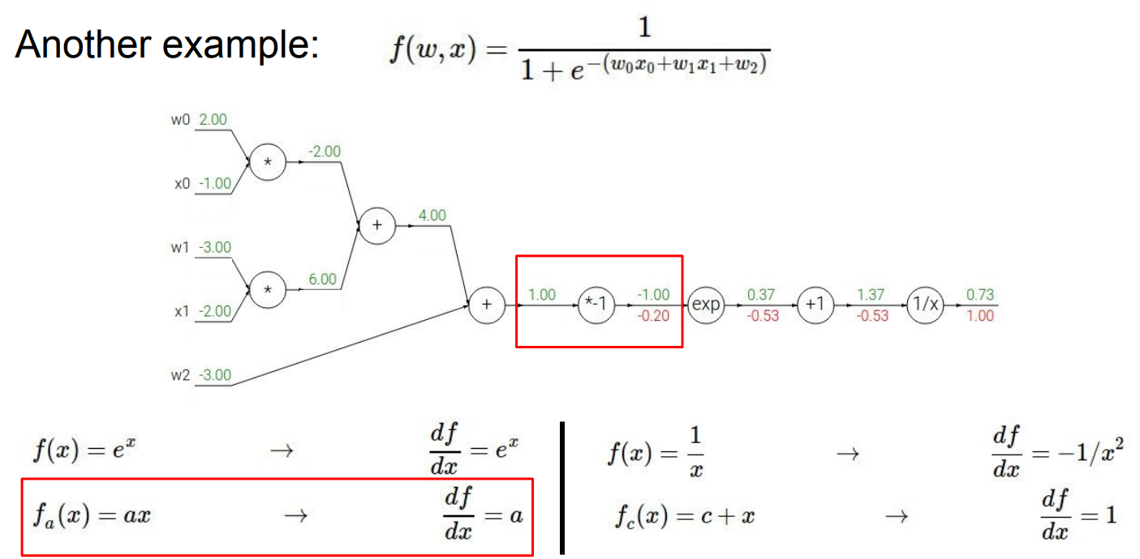

Slide 35
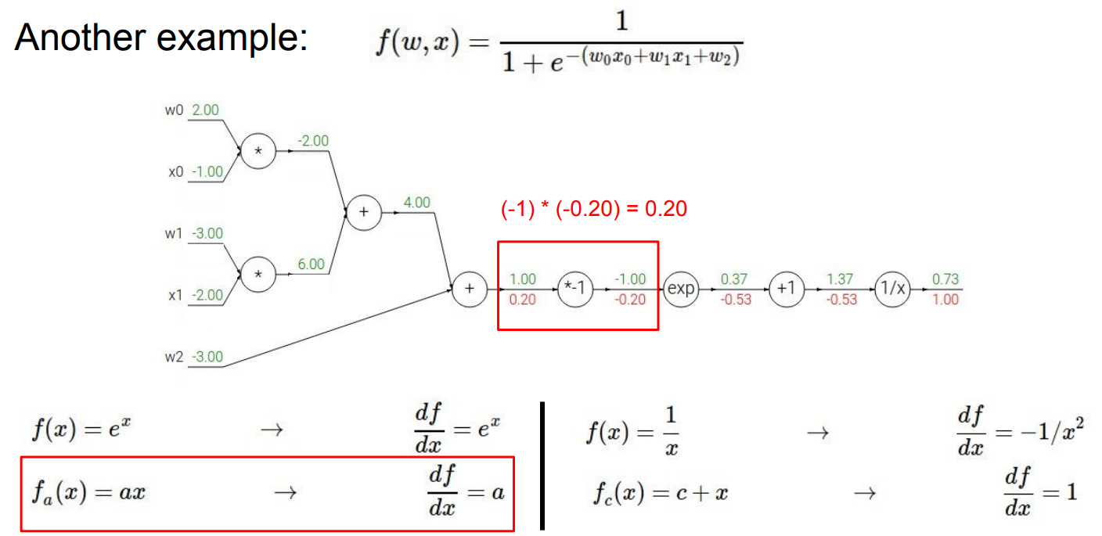

Slide 36
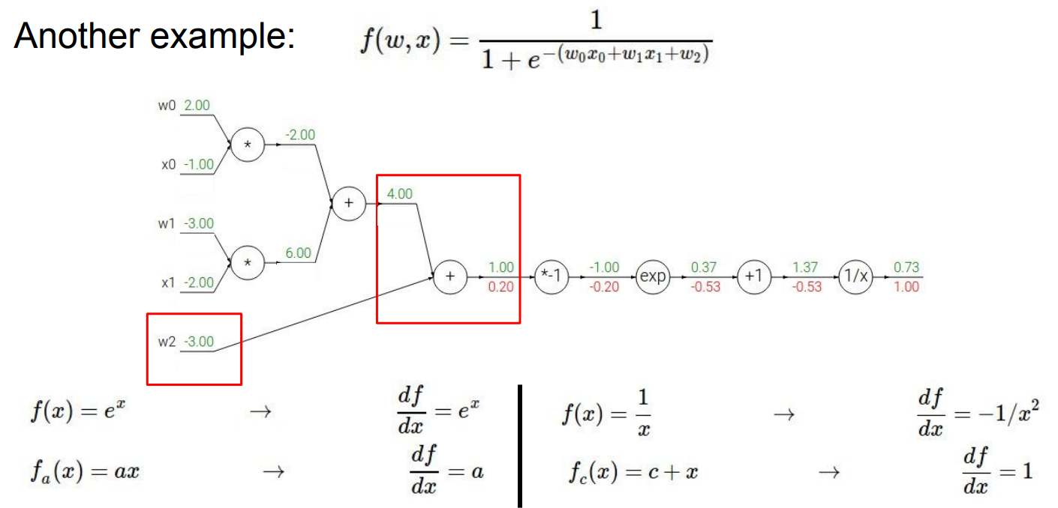

Slide 37
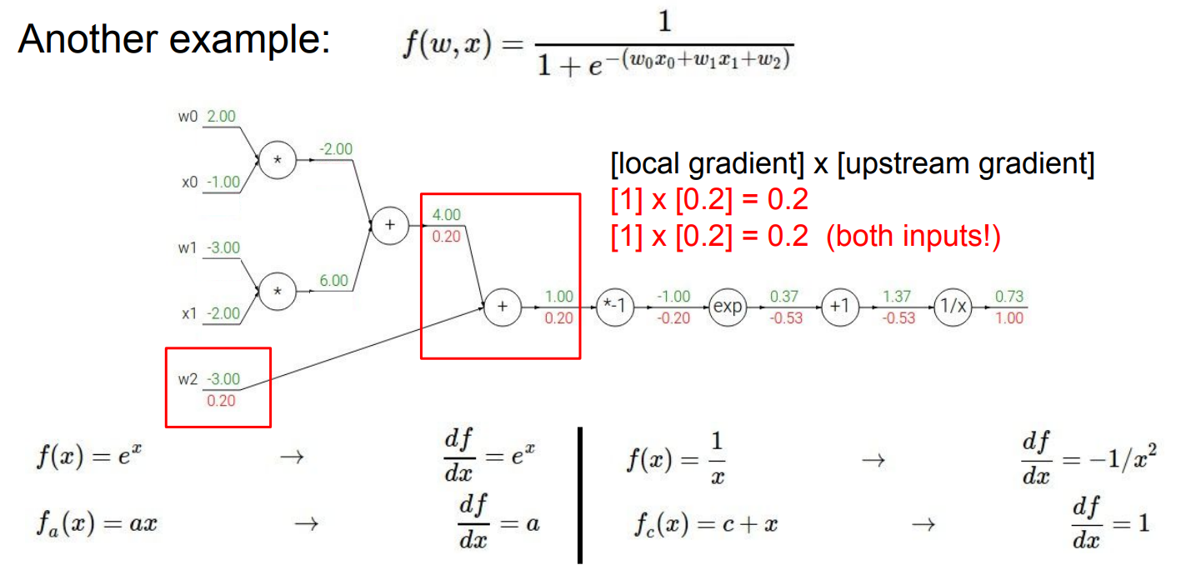

Slide 38
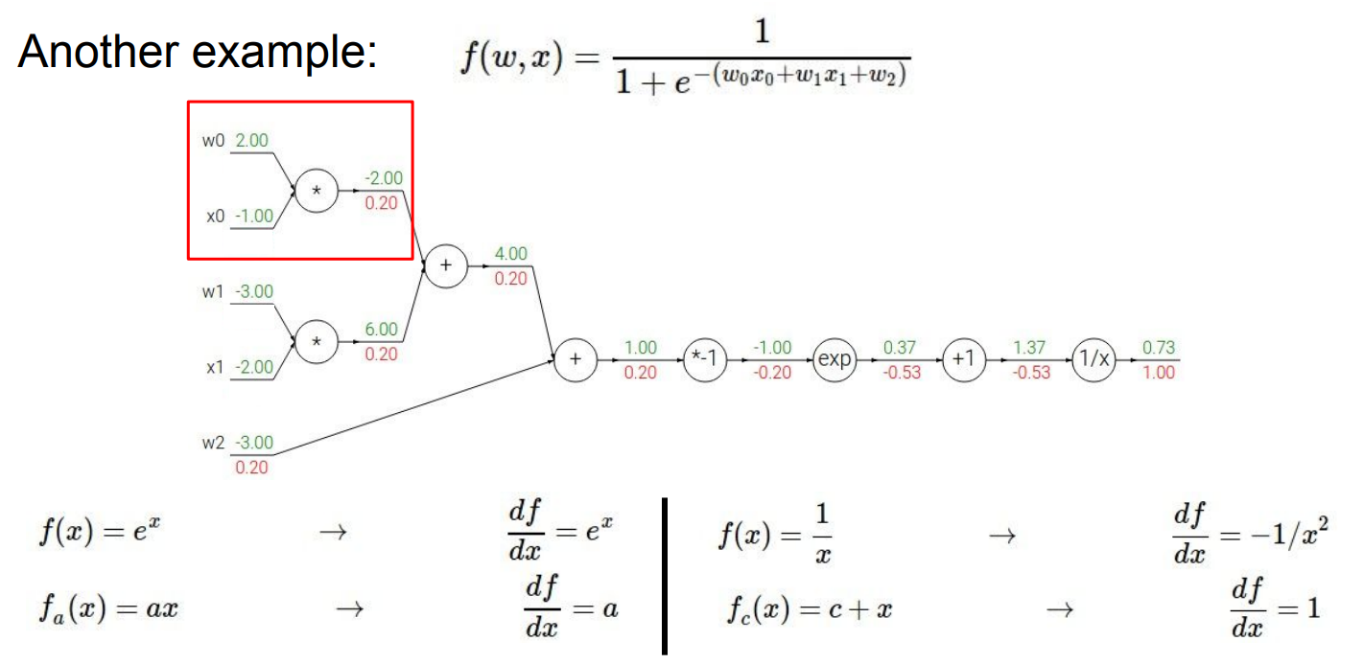

Slide 39
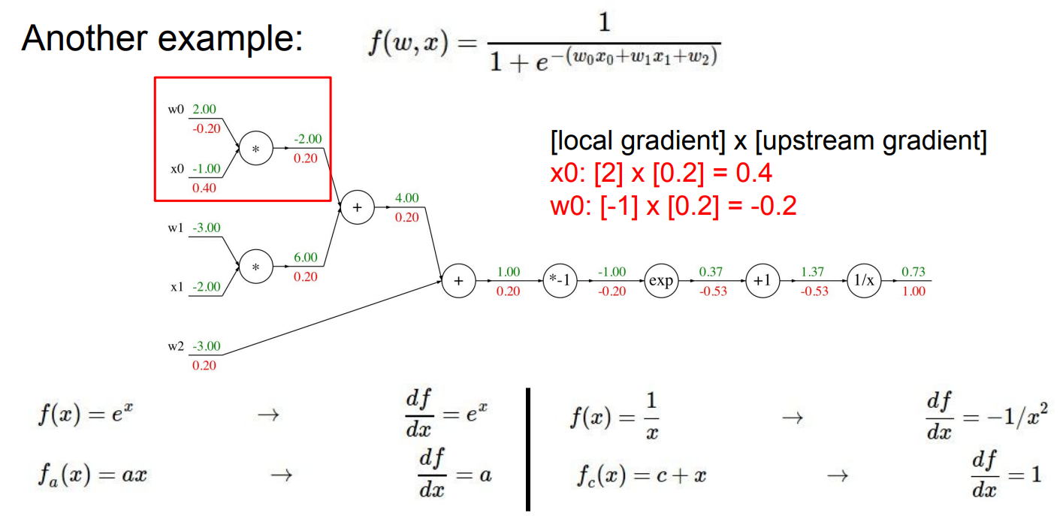

Slide 40
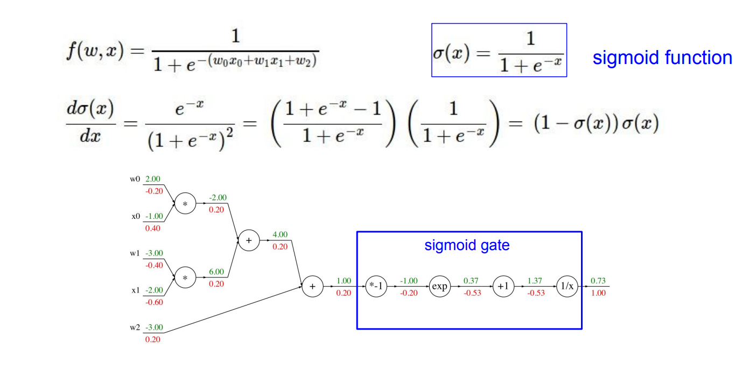

Slide 41
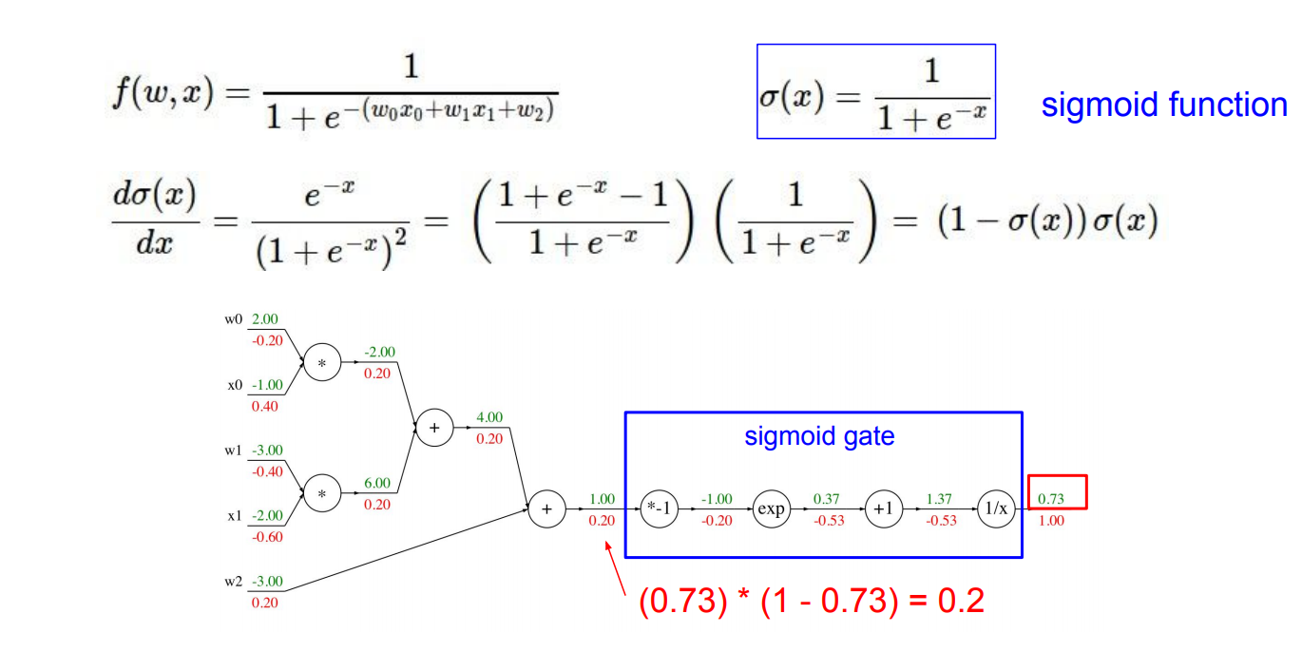

Slide 42
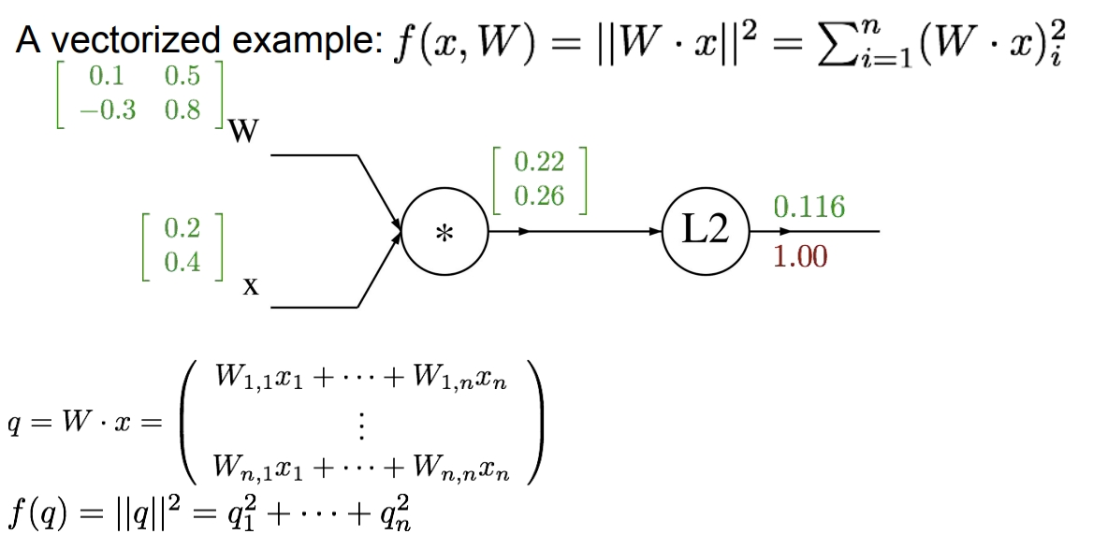

Slide 43
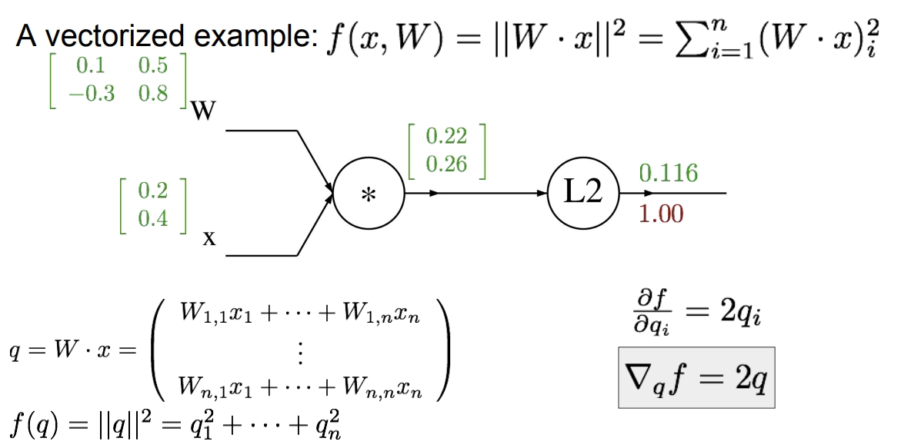

Slide 44
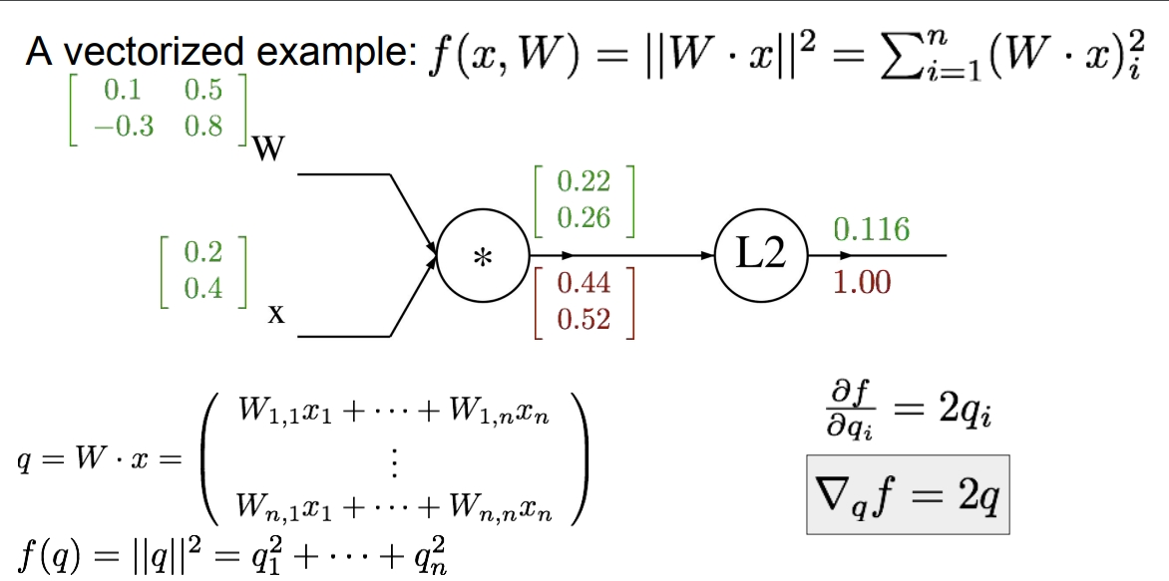

Slide 45
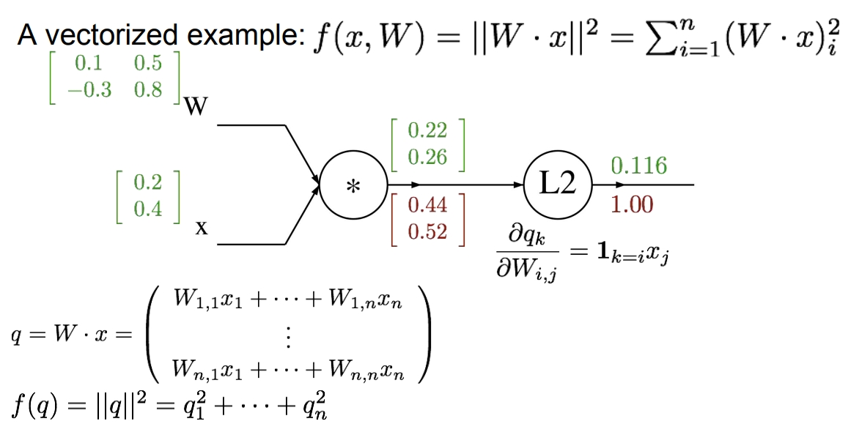

Slide 46
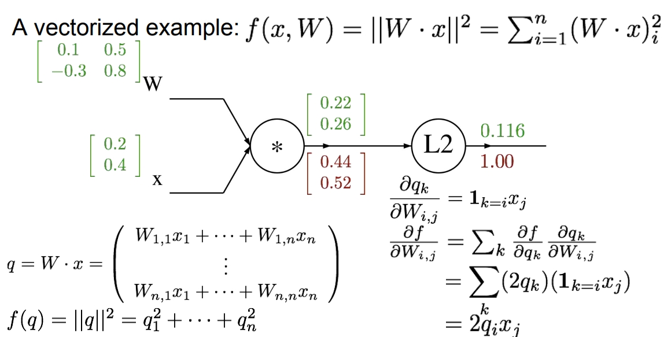

Slide 47
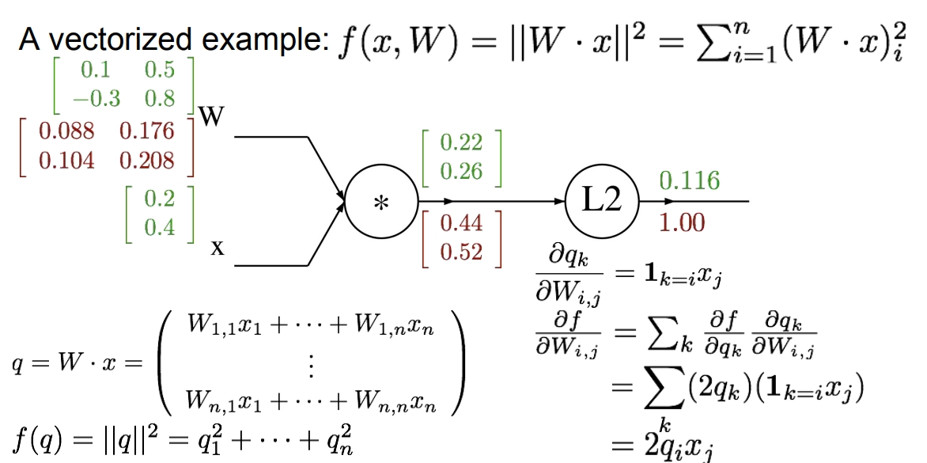

Slide 48
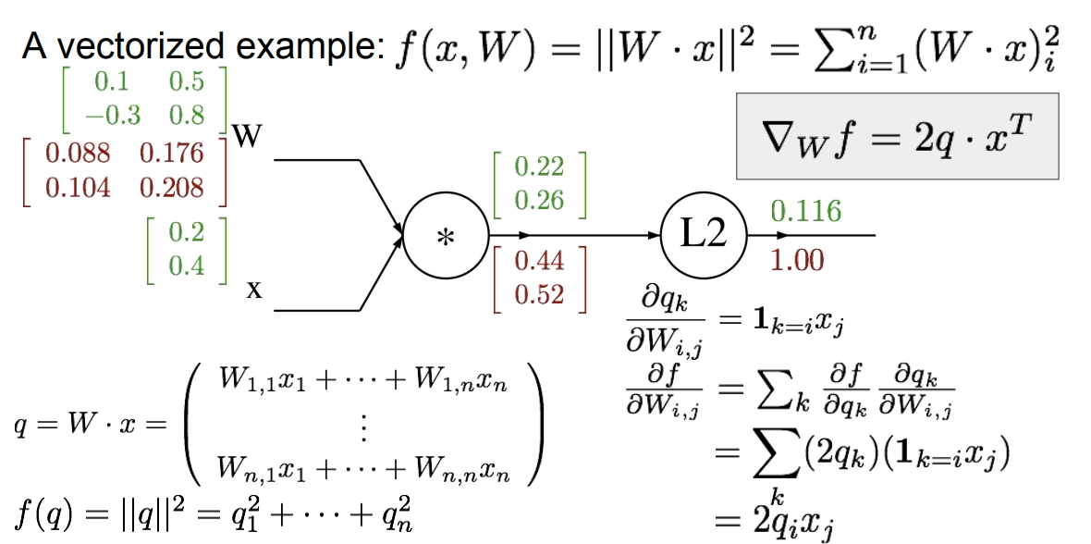

Slide 49
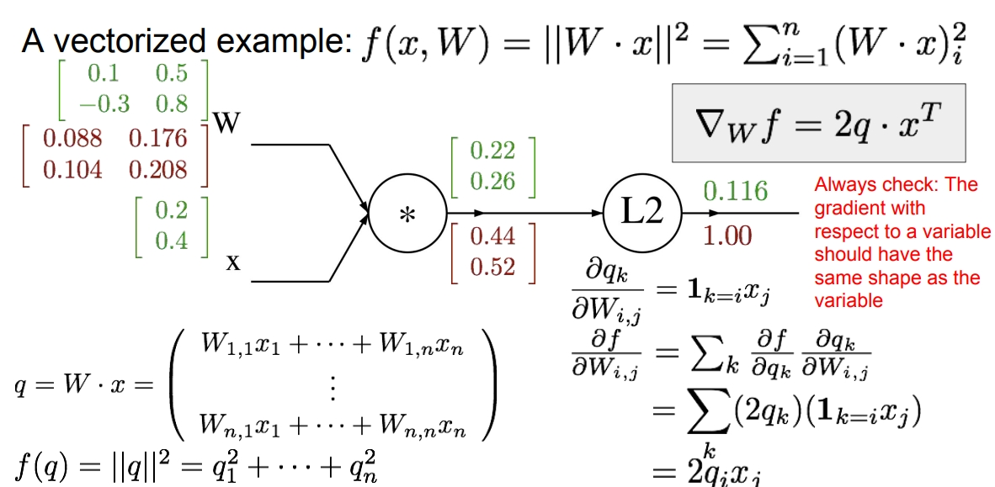

Slide 50
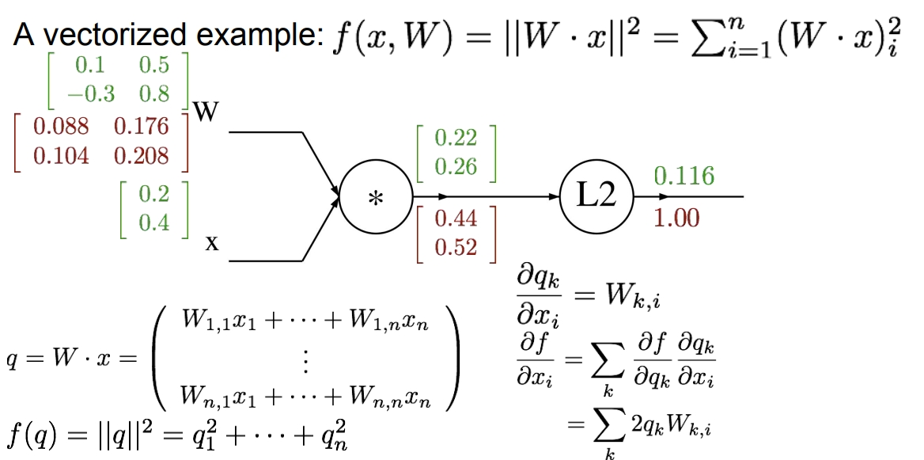

Slide 51
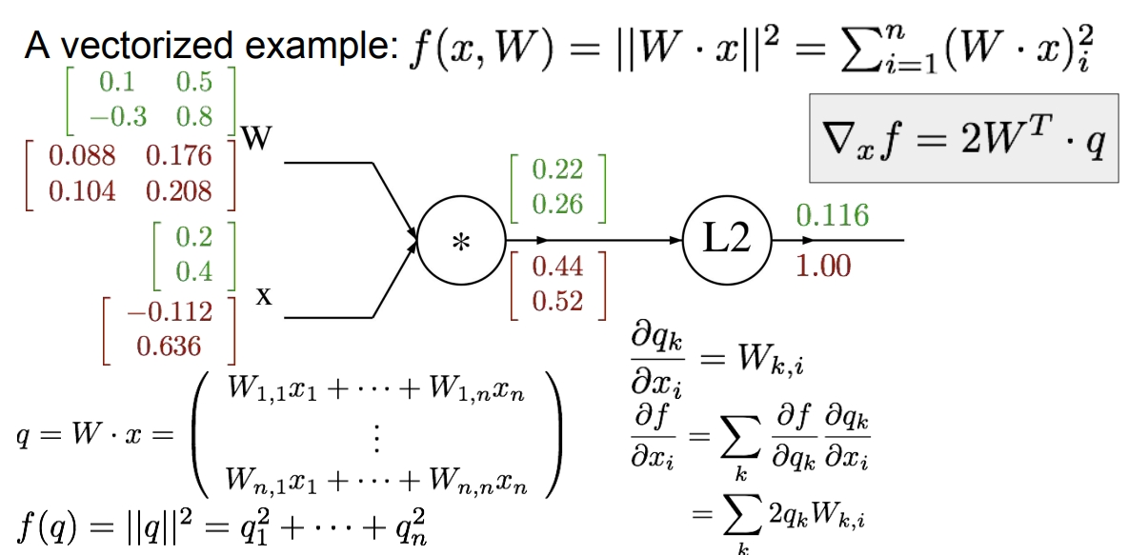

Slide 52
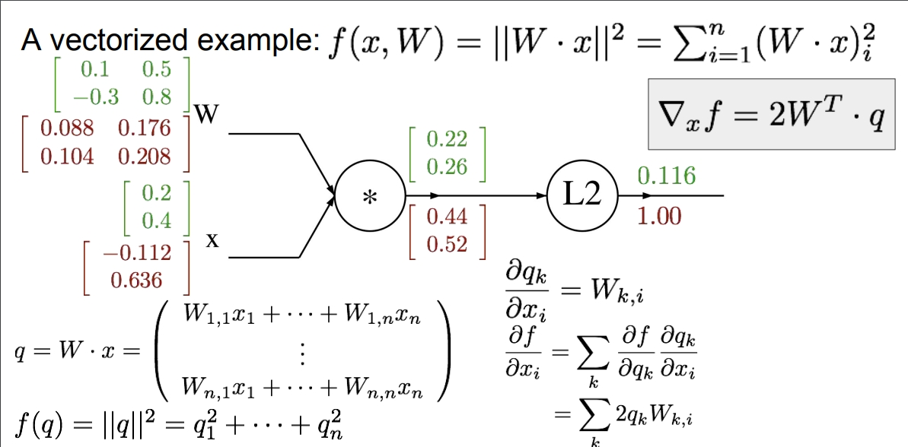

Slide 53
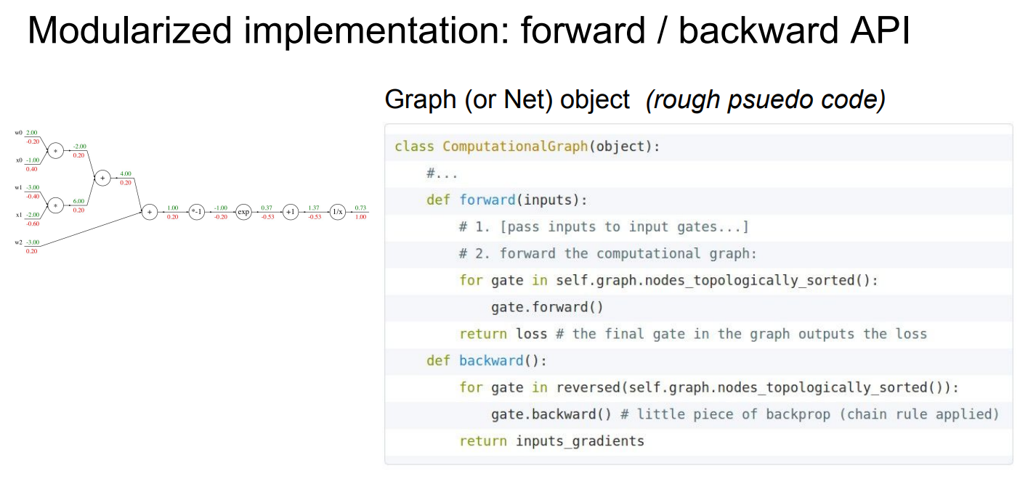

Slide 54


Slide 55


Slide 56


Slide 57


Slide 58


Slide 59


Slide 61


Slide 62


Slide 63


Slide 64
Acknowledgements
A lot of slides were ‘borrowed’ from Stanford’s CS231n course. I did that not because I am that lazy (everyone says that, right?), but because I find those slides the best possible slides on backpropagation. Andrej Karpathy invented a new way of explaining back-propagation, and to date, it is the only explanation which doesn’t end on bad dreams at night.

Slide 65
Recommended readings (and videos)
A. Karpathy’s blog post on back-propagation.
CS231n (Karpathy/Johnson) notes on back-propagation.
CS231n lecture on back-propagation.
Deep Learning book (Goodfellow et al.) - Chapter 6.
Deep Conspiracy’s paper on deep learning.
J. Schmidhuber’s paper on deep learning.

Slide 66

Questions???

